Slide 1
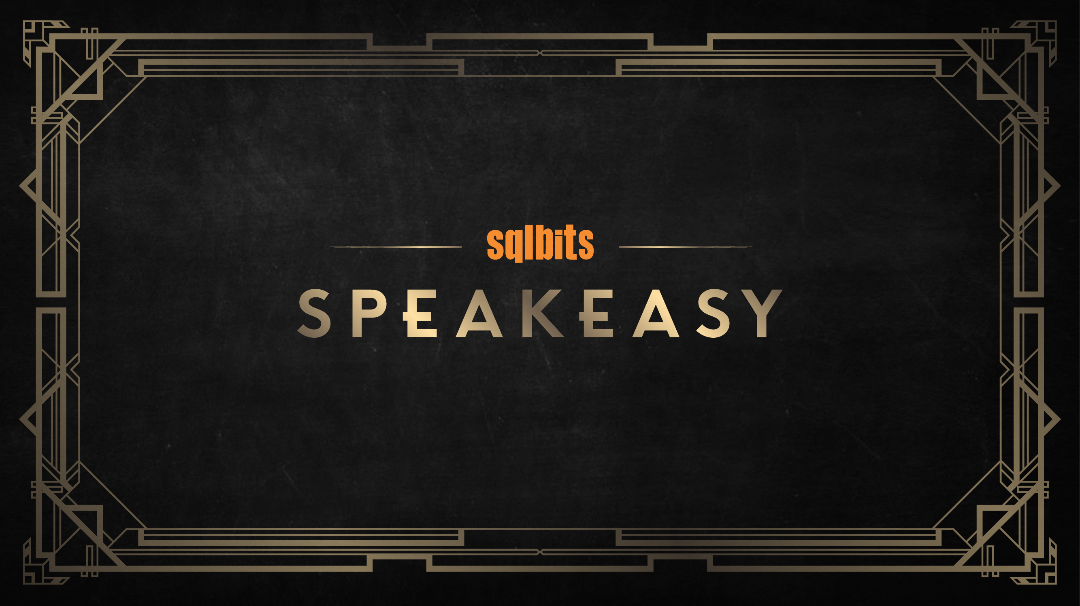

Slide 2

Running SQL Server on RDS
John McCormack

Slide 3
Introduction
John McCormack
DBA since 2012
Initially focused on SQL Server, now also various cloud technologies.
RDS
S3, Glue, Athena
Azure
MCSE Data Management and Analytics
AWS Certified Solutions Architect – Associate

Slide 4
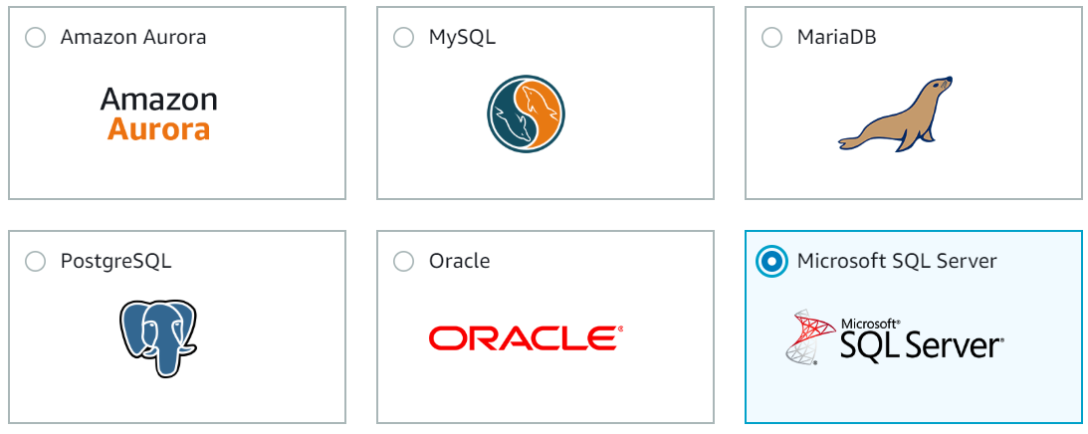
Terminology
AWS – Amazon Web Services (Cloud computing company)
RDS – Relational database service
S3 – Object storage based in AWS (think dropbox)
Bucket – A globally unique resource name in S3

Slide 5
RDS IS A MANAGED SERVICE
FEATURE | RDS
Always On Availability Groups (New) | ✔
Use database as source or target for SSIS | ✔
AWS-managed Multi AZ deployment | ✔
Automated backups | ✔
Automated patching | ✔
Full control over the instance | X

Slide 6
IF YOU NEED THIS, DON’T USE RDS
FEATURE | RDS
Bulk Insert / OPENROWSET(BULK...) | X
Log Shipping | X
Replication | X
Database mail | X
File Tables / FileStream | X

Slide 7
RDS LICENSING
No Developer Edition
Express edition is the only license free edition
License included in instance cost (Enterprise, Standard & Web)
No BYOL

Slide 8
BACKUP / RESTORE
Automated backups stored in S3 (not your bucket though)
Set your own retention period (0 - 35 days)
Take ad-hoc snapshots to your own S3 bucket (Kept until you delete it)
Snapshots can be shared between accounts
Accounts are similar to subscriptions in Azure so sometimes used for restoring prod to dev or test environments
Point in time restores (within 5 minutes)

Slide 9
Command Line CLI & PowerShell
The key to cloud automation is scripting. AWS supports CLI and Powershell to save you from too many clunky manual process.
Examples
aws rds restore-db-instance-from-db-snapshot --db-instance-identifier restored-test-instance --db-snapshot-identifier test-instance-snap
Restore-RDSDBInstanceFromDBSnapshot-DBInstanceIdentifier restored-test-instance -DBSnapshotIdentifier test-instance-snap

Slide 10
If you want to find out more, go here:
https://johnmccormack.it/2018/11/how-do-i-run-sql-server-on-aws/
https://johnmccormack.it/2019/03/running-sql-server-on-rds-sqlbits-presentation/
bit.ly/sql_on_aws
https://johnmccormack.it
@actualjohn

